Slide 1
Lecture 10 Pumping Lemma
A property of regular sets

Slide 2
Weak version
Strong version
Applications

Slide 3
Pumping Lemma (weak)
If a language L is accepted by a DFA M with m states, then any string x in L with |x| > m can be written as x = uvw such that
(1) v ≠ε, and
(2) uv*w is a subset of L
(i.e., for any n> 0, uv w in L).
n

Slide 4
Proof
Consider the path associated with x (|x| > m).
x
Since |x| > m, # of nodes on the path is
At least m+1. Therefore, there is a state
Appearing twice.

Slide 5
v
u
w
v ≠ ε
because M is DFA
uw in L
because there is a path associated with
uw from initial state to a final state.
n
uv w in L
due to the same reason as above

Slide 6
L={0 | n is a prime} is not regular.
n
Proof. For contradiction, suppose L is regular. So, L=L(M) for some DFA M.
Let m be the number of states of M. Consider a prime p > m. By Pumping Lemma, 0 = uvw such that v≠ε and
uv*w is a subset of L. Thus,
p = |u| + |v| + |w|
and for any k > 0, |u|+k|v|+|w| is a prime.
p

Slide 7
For k =0, |u|+|w| is a prime.
For k=|u|+|w|, |u|+k|v|+|w|
= (|u|+|w|)(1+|v|)
is a prime. (-><-)

Slide 8
i
i
L={0 1 | i > 0 } is not regular.
Proof.
For contradiction, suppose L is regular. So,
L= L(M) for some DFA M.
m
m
Suppose M has m states. Consider 0 1 .
m
m
By Pumping Lemma, 0 1 = uvw such that
v ≠ ε and for n > 0, uv w in L.
n
m
Case 1. v is a substring of 0 .
uw in L, but uw contains less 0’s than 1’s. (-><-)
m
Case 2. v is a substring of 1 .
uw in L, but uw contains less 1’s than 0’s. (-><-)

Slide 9
Case 3. v contains both 0 and 1.
uvvw in L, but uvvw contains 10. (-><-)

Slide 10
Pumping Lemma (strong)
If a language L is accepted by a DFA M with m states, then any string xyz in L with |y| > m can be written as y = uvw such that (1) v ≠ ε, and
(2) xuv*wz is a subset of L.
(for n>0, xuv wy in L)
n

Slide 11
Proof
Since M is DFA, there is a path from initial state to a final state, associated with xyz.
x
y
z
p
q
Since |y|>m, there are at least m+1 nodes
between p and q. Hence, there is a state r
appearing twice.

Slide 12
v
x
w
z
p
u
r
q
v≠ε
because M is DFA (without ε-move).
xuwz in L
because a path associated with xuwz
exists from initial state to a final state.
xuvvwz in L
because a path associated with xuvvwz
exists from initial state to a final state.
n
xuv wz in L

Slide 13
i
i
L={0 1 | i > 0 } is not regular.
Proof.
For contradiction, suppose L is regular. So,
L= L(M) for some DFA M.
m
m
Suppose M has m states. Consider 0 1 .
m
By Pumping Lemma, 0 = uvw such that
v ≠ ε and for n > 0, uv w1 in L.
n
m
m
uw1 in L, but uw contains less than m 0’s. (-><-)

Slide 14
L={x in (0+1)* | #1(x) = #0(x) } is not regular.
Proof.
For contradiction, suppose L is regular. So,
L= L(M) for some DFA M.
m
m
Suppose M has m states. Consider 0 1 .
m
By Pumping Lemma, 0 = uvw such that
v ≠ ε and for n > 0, uv w1 in L.
n
m
m
uw1 in L, but uw contains less than m 0’s. (-><-)

Slide 15
i
j
L={0 1 | i > j > 0 } is not regular.
Proof.
For contradiction, suppose L is regular. So,
L= L(M) for some DFA M.
m
m
Suppose M has m states. Consider 0 1 .
m
By Pumping Lemma, 0 = uvw such that
v ≠ ε and for n > 0, uv w1 in L.
n
m
m
uw1 in L, but uw contains less than m 0’s. (-><-)

Slide 16
i
j
L={0 1 | i > j > 0 } is not regular.
Proof.
For contradiction, suppose L is regular. So,
L= L(M) for some DFA M.
m
m
Suppose M has m states. Consider 00 1 .
m
By Pumping Lemma, 0 = uvw such that
v ≠ ε and for n > 0, 0uv w1 in L.
n
m
m
0uw1 in L, but uw contains less than m 0’s. (-><-)

Slide 17
i
j
k
L={a b c | i + j = k, i > 0, j > 0, k > 0 } is not regular.
Proof.
For contradiction, suppose L is regular. So,
L= L(M) for some DFA M.
m
m
Suppose M has m states. Consider b c .
m
By Pumping Lemma, b = uvw such that
v ≠ ε and for n > 0, uv wc in L.
n
m
m
uwc in L, but uw contains less than m b’s. (-><-)

Slide 18
2
i
L = { 0 | i > 0 } is not regular.
Proof.
For contradiction, suppose L is regular. So,
L=L(M) for some DFA M.
2
m
Suppose M has m states. Consider 0 .
2
m
By Pumping Lemma, 0 = uvw such that
v ≠ ε and for n > 0, uv w in L.
n
Set a=|v| and b=|uw|. Then a > 0 and for n > 0,
an+b is a square.
Specially, when n=0, b is a square. Set b = cc.
2
When n = a+2c, an+cc = (a+c) .

Slide 19
Now, consider n=a+2c+1.
2
Note that an+b = (a+c) +a.
2
2
2
But, (a+c+1) = (a+c) + 2(a+c) + 1 > (a+c) + a.
2
Hence, (a+c) +a cannot be a square. (-><-)

Slide 20
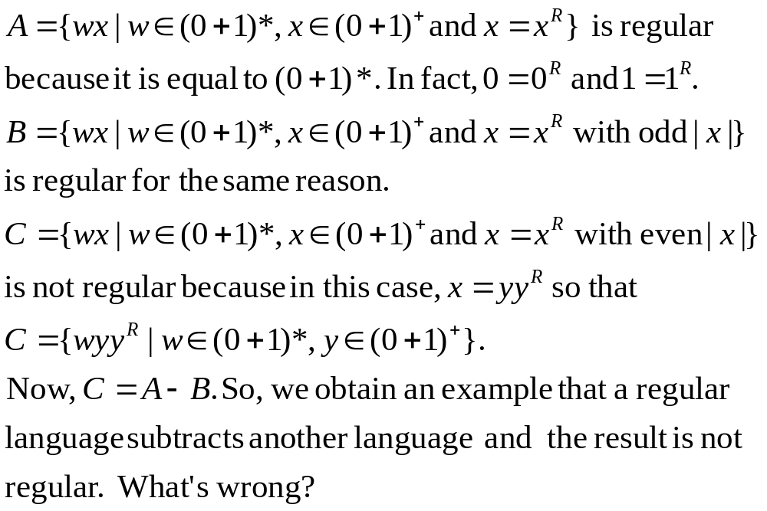
Puzzle

